Slide 1
ActionResult Types in Web API
Sarita Lad
DATE

Slide 2
ResultTypes in WebAPI
In ASP.NET Core Web API, controller actions can return various types of results, ultimately affecting the HTTP response sent to the client. The choice of return type depends on what you need to communicate to the client about the result of the operation performed by the action method. In ASP.NET Core Web API, we can return data from the controller action method in three different ways.

Slide 3
Various Return Types:
Primitive or Complex Types: Actions can return primitive types (like int, string, etc.) or complex types (such as custom objects). When returning these directly, ASP.NET Core serializes the object into JSON (by default) and sets the content type of the response to application/json.
IActionResult: The IActionResult return type can return various HTTP responses, including status codes, files, and error messages. This return type is useful when an action needs to return different types of responses, such as NotFound(), OK(), BadRequest(), etc.
ActionResult<T>: The ActionResult<T> return type allows for returning either a response that can be serialized into JSON (or another format) or an action result (like IActionResult). This provides more flexibility in return types, allowing for both the return of data (as type T) and action results like NotFound() or Ok().
Specific Result Types: ASP.NET Core provides several specific result types that implement the IActionResult interface and are used to return specific types of responses. Examples include Ok, BadRequest, NotFound, and File. These result types offer a clearer intention of the HTTP response returned from the API.

Slide 4
Void: Returning void from an action method results in an empty 204 No Content response. This is typically used when an action performs an operation that does not need to return data to the client.
Task<IActionResult> or Task<ActionResult<T>>: For asynchronous operations, actions can return Task<IActionResult> or Task<ActionResult<T>>. This enables the action methods to perform asynchronous operations, like database calls or web service requests, without blocking the calling thread. The framework handles the task completion and writes the result to the response.

Slide 5
IActionResult Return Type in ASP.NET Core Web API:
The IActionResult return type is used when the action method will return different types of data. The IActionResult return type is capable of representing various HTTP status codes. It’s the most flexible return type because it can return different types of responses, such as OK, BadRequest, NotFound, and many more from your action method.
This is useful when your action method needs to return different HTTP responses based on the outcome of the operation. For example, if you want to return NotFound, OK, Redirect, etc. data from your action method, then you need to use IActionResult as the return type from your action method.

Slide 6
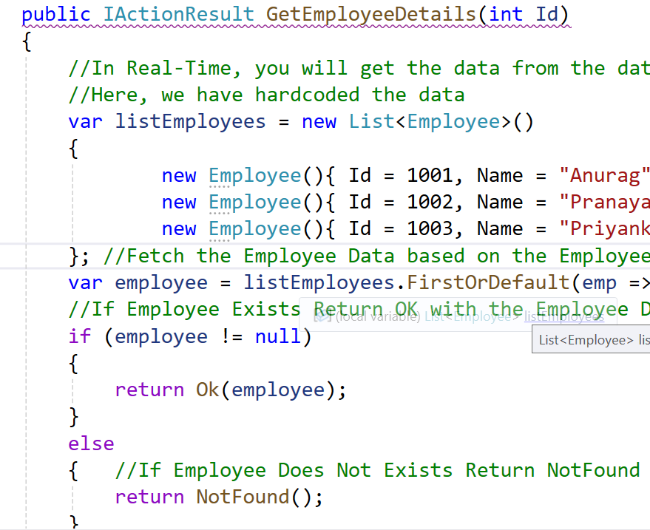
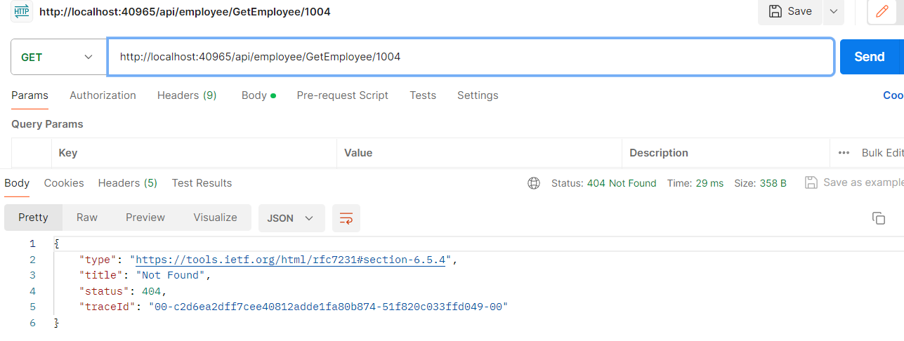
IActionResult:example WebAPI_ResultTypes_Demo

Slide 7
we returned two different types of data from the same action method, GetEmployeeDetails. The IActionResult is an Interface and allows us to return multiple types. You can return the data using some built-in methods as follows,
OK()
NotFound()
Content()
File()
Redirect, Etc.

Slide 8
Benefits of using IActionResult type in ASP.NET Core Web API
The IActionResult type in ASP.NET Core Web API provides several benefits that enhance web application development, maintenance, and scalability. It is a flexible and unified way to return different types of responses from controller actions. Here are some of the key benefits:
Flexibility in Response Types: IActionResult allows an action method to return various response types, such as OK, BadRequest, NotFound, or File. This flexibility lets developers easily handle responses to the needs of different API calls without having to change the method signature.
Improved Readability and Maintainability: By using IActionResult, the intent of the code becomes clearer. For instance, returning Ok(result) or NotFound() directly from an action method makes it easy to understand the possible outcomes of the API call, improving the maintainability of the code.
Support for Asynchronous Operations: ASP.NET Core supports asynchronous action methods, allowing for non-blocking I/O operations. IActionResult can be used with asynchronous patterns, such as Task<IActionResult>, to improve the scalability and performance of web applications by efficiently handling web requests.
Enhanced Client-Side Interaction: By using standardized responses provided by IActionResult, such as status codes and content results, client-side applications can more easily interpret and react to the API responses. This standardization helps in building robust client-server communication.

Slide 9
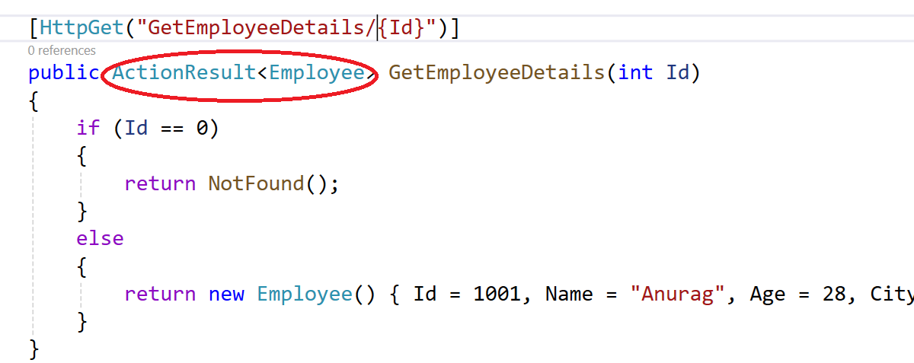
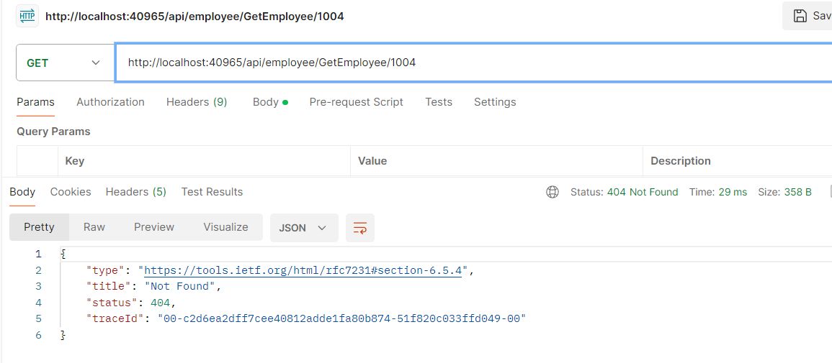
ActionResult<T> Return Type in ASP.NET Core Web API:
ActionResult<T> extends IActionResult by allowing you to return either a response type that implements IActionResult or return a specific type T. So, it is the combination of ActionResult and Specific type. It enables us to return a type deriving either from ActionResult or a specific type.

Slide 10
Thank You

